Slide 1
Cryptography and Network Security
1

Slide 2
Course Outcomes
After completion of this course student will be able to:
1. Classify the security attacks, security services and also describe the model for
network Security.[L2]-U1
2. Analyze conventional and Public cryptographic techniques.[L4]-U2
3. Classify and analyze Message Authentication, Secure Hash functions and outline the
concepts of Kerberos and email privacy.[L3]-U3
4. Examine architecture, key management and header formats of IPsec and Outline the
various web security threats and protocols.[L3]-U4,U5
5. Interpret Intrusion Detection System and Design principles of Firewalls.[L3]-U6

Slide 3
Contents
UNIT – I : Security Attacks (Interruption, Interception, Modification and Fabrication), Security Services (Confidentiality, Authentication, Integrity, Non-repudiation, access Control and Availability) and Mechanisms, A model for Internetwork security, Internet Standards and RFCs.
UNIT – II: Conventional Encryption Principles, Conventional encryption algorithms: DES, TDES, AES, RC4, cipher block modes of operation, location of encryption devices, key distribution, Public key cryptography principles, public key cryptography algorithms: RSA, DIFFIE
HELL MAN
UNIT – III: Digital signatures, digital Certificates, Certificate Authority and key management, Approaches of Message Authentication, Secure Hash Functions: SHA1 and HMAC Kerberos, X.509 Directory Authentication Service. Email privacy: Pretty Good Privacy (PGP) and S/MIME.

Slide 4
Contents (2)
UNIT – IV: IP Security Overview, IP Security Architecture, Authentication Header, Encapsulating Security Payload, Combining Security Associations and Key Management.
UNIT – V: Web Security Requirements, Secure Socket Layer (SSL) and Transport Layer Security (TLS), Secure Electronic Transaction (SET). Intruders, Viruses and related threats
UNIT – VI: Firewall Design principles, Trusted Systems. Intrusion Detection Systems.
TEXT BOOKS:
1. Network Security Essentials (Applications and Standards) by William Stallings
Pearson Education, 4th Edition.
2. Hack Proofing your network by Ryan Russell, Dan Kaminsky, Rain Forest Puppy,
Joe Grand, David Ahmad, Hal Flynn Ido Dubrawsky, Steve W.Manzuik and Ryan
Permeh, wiley Dreamtech

Slide 5
Unit 1 Contents
Security Attacks: Interruption, Interception, Modification and Fabrication
Security Services: Confidentiality, Authentication, Integrity, Non-repudiation, access Control and Availability
Security Mechanisms,
A model for Internetwork security,
Internet Standards and RFCs.

Slide 6
Attacks, Services and Mechanisms
Security Attack: Any action that compromises the security of information.
Security Mechanism: A mechanism that is designed to detect, prevent, or recover from a security attack.
Security Service: A service that enhances the security of data processing systems and information transfers. A security service makes use of one or more security mechanisms.
6

Slide 7
Security Threats
7

Slide 8
Security Threats
Interruption: This is an attack on availability
Interception: This is an attack on confidentiality
Modification: This is an attack on integrity
Fabrication: This is an attack on authenticity
8

Slide 9
Security Goals
Confidentiality
Integrity
Avalaibility
9

Slide 10
Security Attacks
10

Slide 11
Security Services
Confidentiality (privacy)
Authentication (who created or sent the data)
Integrity (has not been altered)
Non-repudiation (the order is final)
Access control (prevent misuse of resources)
Availability (permanence, non-erasure)
Denial of Service Attacks
Virus that deletes files
11

Slide 12
A. Data confidentiality
These services provide for the protection of data from unauthorized disclosure as described below
Connection confidentiality - provides for the confidentiality of all user-data on a connection
Connectionless confidentiality - provides for the confidentiality of all user-data in a single data block.
Selective field confidentiality - provides for the confidentiality of selected fields within the user-data on a connection or in a single data block.
Traffic flow confidentiality This service provides for the protection of the information which might be derived from observation of traffic flows.

Slide 13
B. Authentication
The Assurance that the communicating entity is the one that it claims it to be.
Peer entity authentication This service, when provided by the (N)-layer, provides validation to the (N - 1)-entity that the peer entity is the claimed (N)-entity.
Data origin authentication (aka Message Authentication) -Assurance that the source of the data or information is verified. It is based on the idea that a block of data is only processed and recorded by one node..

Slide 14
C. Integrity
Assurance that data received are exactly as sent by an unauthorized entity (i.e. contain no modification, insertion, deletion or replay.
Connection integrity with recovery
provides for the integrity of all user-data on a connection
detects any modification, insertion, deletion or replay of any data within an entire data sequence (with recovery attempted).
b) Connection integrity without recovery
the previous one but with no recovery attempted.
c) Selective field connection integrity –
provides for the integrity of selected fields within the user data of data block transferred over a connection and determine whether the selected fields have been modified, inserted, deleted or replayed.

Slide 15
C. Integrity (contd..)
Connectionless integrity
provides for the integrity of a single data block
determine whether a received data block has been modified.
Additionally, a limited form of detection of replay may be provided.
e) Selective field connectionless integrity
provides for the integrity of selected fields within a single connectionless data block
determine whether the selected fields have been modified.

Slide 16
D. Non-repudiation
Provides protection against denial by one of the entities involved in a communication of having participated in all or part of the communication.
Non-repudiation , Origin
Proof that the message was sent by the specified party -
This will protect against any attempt by the sender to falsely deny sending the data or its contents.
Non-repudiation, Destination
Proof that the message was message was received by the specified party
This will protect against any subsequent attempt by the recipient to falsely deny receiving the data or its contents.

Slide 17
E. Access control
Provides protection against unauthorized use of resources accessible
Example: the service controls who can have access to a resource, under what circumstances, and what those accessing the resource are allowed to do.

Slide 18
F. Availability
The property of a system or a system resource being accessible and usable upon demand by an authorized system entity.

Slide 19
Security Mechanisms
Security Mechanism: A mechanism that is designed to detect, prevent, or recover from a security attack.
Sec. Mech. Types
Specific security mechanisms
Pervasive security mechanisms
May be incorporated into the appropriate protocol layer in order to provide some of the OSI security services.
Mechanisms that are not specific to any particular OSI security service or protocol layer.

Slide 20
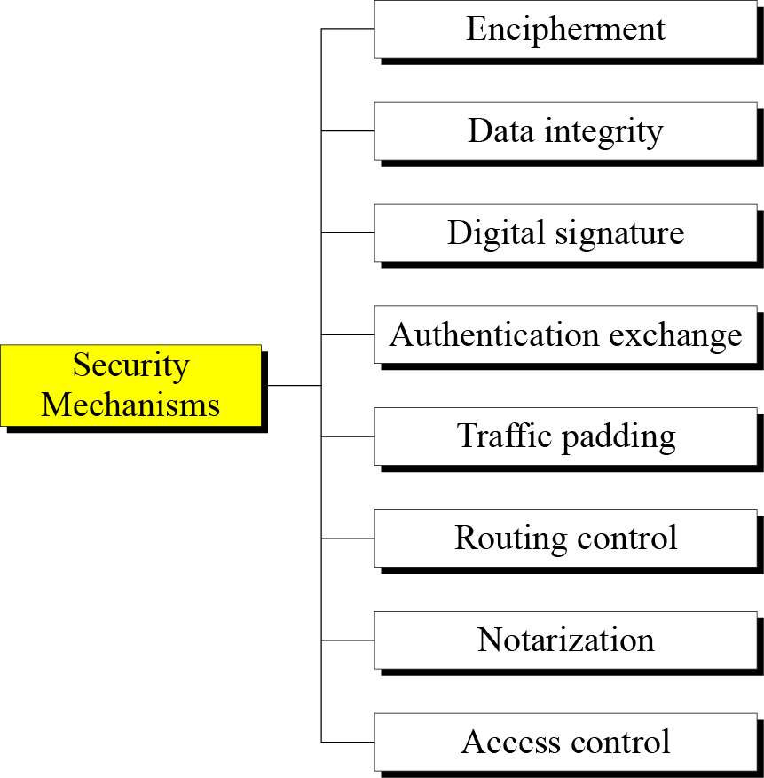
Specific Security Mechanisms
Notes:
1.#

Slide 21
Mechanisms | Explanation
Encipherment | The use of mathematical algorithms to transform data into a form that is not readily intelligible. The transformation and subsequent recovery of the data depend on an algorithm and zero or more encryption keys.
Digital Signature | Data appended to, or a cryptographic transformation of, a data unit that allows a recipient of the data unit to prove the source and integrity of the data unit and protect against forgery (e.g., by the recipient). See
Access Control | Mechanisms that enforce access rights to resources.
Data Integrity | Mechanisms used to assure the integrity of a data unit or stream of data units.
Authentication Exchange | A mechanism intended to ensure the identity of an entity by means of information exchange
Traffic Padding | The insertion of bits into gaps in a data stream to frustrate traffic analysis attempts.
Routing Control | Enables selection of particular physically secure routes for certain data and allows routing changes, especially when a breach of security is suspected.
Notarization | The use of a trusted third party to assure certain properties of a data exchange.

Slide 22
Relationship between Security Services and Mechanisms
Mechanism
Service | Encipherment | Digital Signature | Access Control | Data Integrity | Authentication Exchange | Traffic Padding | Routing Control | Notarization
Peer entity authentication | Y | Y |  |  | Y
Data origin authentication | Y | Y
Access control |  |  | Y
Confidentiality | Y |  |  |  |  |  | Y
Traffic flow confidentiality | Y |  |  |  |  | Y | Y
Data integrity | Y | Y |  | Y
Nonrepudiation |  | Y |  | Y |  |  |  | Y
Availability |  |  |  | Y | Y

Slide 23
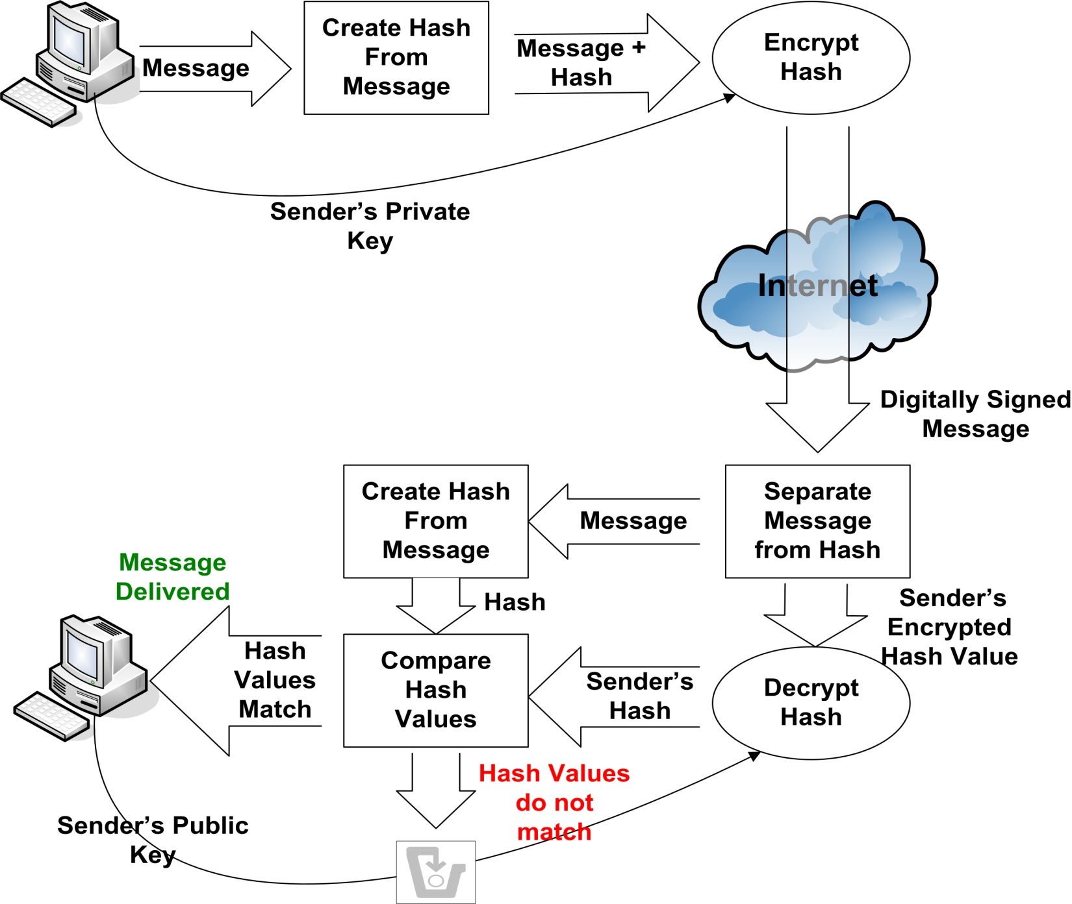
Digital Signature
digital signature – mathematical scheme for demonstrating the authenticity of a digital message or document.

Slide 24
Pervasive security mechanisms
Mechanisms | Explanation
Trusted Functionality | That which is perceived to be correct with respect to some criteria (e.g., as established by a security policy).
Security Label | The marking bound to a resource (which may be a data unit) that names or designates the security attributes of that resource.
Event Detection | Detection of security-relevant events.
Security Audit Trail | Data collected and potentially used to facilitate a security audit, which is an independent review and examination of system records and activities.
Security Recovery | Deals with requests from mechanisms, such as event handling and management functions, and takes recovery actions.

Slide 25
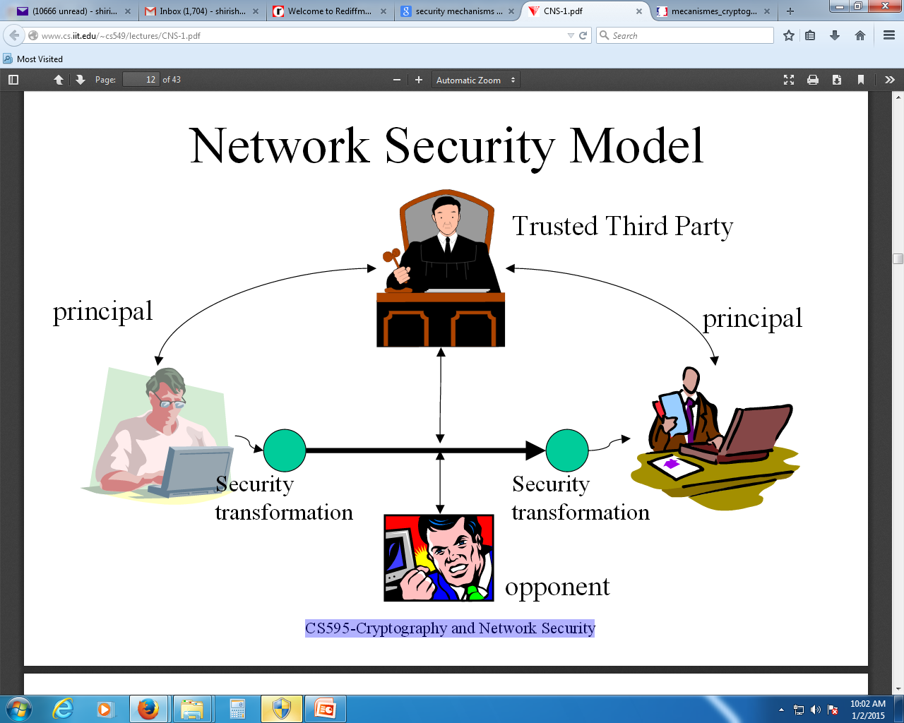

Slide 26
Henric Johnson
26

Slide 27
27

Slide 28
Methods of Defence
Encryption
Software Controls (access limitations in a data base, in operating system protect each user from other users)
Hardware Controls (smartcard)
Policies (frequent changes of passwords)
Physical Controls
28

Slide 29
Internet standards and RFCs
The Internet society – coordinating committee for Internet design, engineering, mgmt.
Internet Architecture Board (IAB)
Internet Engineering Task Force (IETF)
Internet Engineering Steering Group (IESG)
29

Slide 30
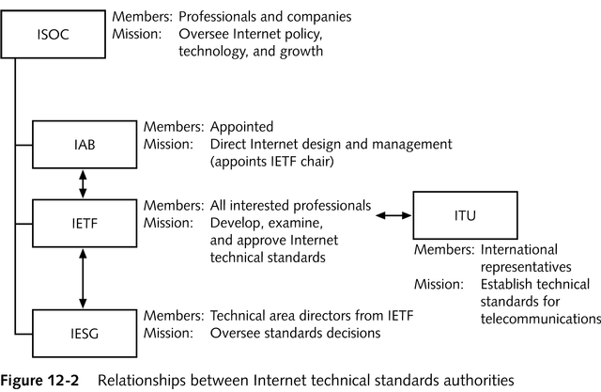
Technical Specifications

Slide 31
Internet RFC Publication Process
31

Slide 32
Recommended Reading
Pfleeger, C. Security in Computing. Prentice Hall, 1997.
Mel, H.X. Baker, D. Cryptography Decrypted. Addison Wesley, 2001.

